Slide 1
Daisy Quorum Gene Drive
By Jackie Chea
Notes:
Today I’m going to be talking about daisy quorum gene drive, which is the potential solution to many problems in public health and ecology.

Slide 2
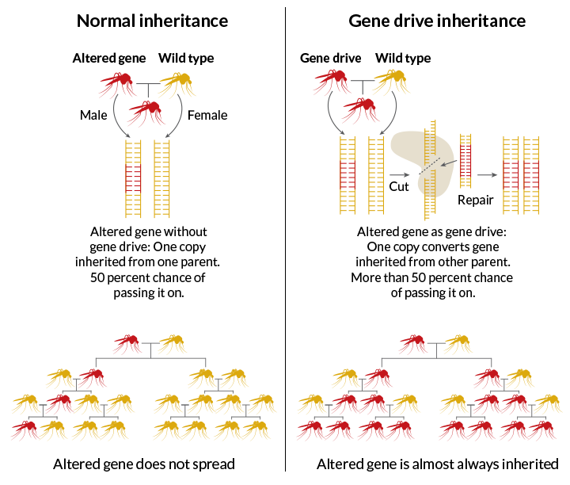
Notes:
If we could genetically alter wild populations, we could potentially eradicate malaria by removing the malaria-carrying gene from mosquitoes. One promising mechanism is through drive.
Let’s say we release a small number of red mosquitoes into the wild yellow population. With normal inheritance patterns, the number of red mosquitoes in the population would quickly die out. With gene drive, we include something extra in the engineered allele: a pair of scissors called Cas9. The engineered allele cuts the other allele, and when it is repaired, it matches the engineered allele. This ensures that more engineered alleles are passed on. Even if we started with only a small number of red mosquitoes in the population, they would soon overtake the number of yellow mosquitoes.
However, one of the biggest dangers with drive is that it could also spread to populations where we don’t want it to go. Let’s say we’re doing a trial of gene drive on an island. As expected, the engineered allele spreads across the entire island wild population. Great. But what if a few individuals escaped to the mainland? The engineered allele would soon overtake the population there too.
We want to keep it contained. How do we do that? That’s what daisy quorum gene drive is for!
----------------------------------
Drive: engineering an allele to bias its inheritance so that it will spread rapidly throughout a population.

Slide 3
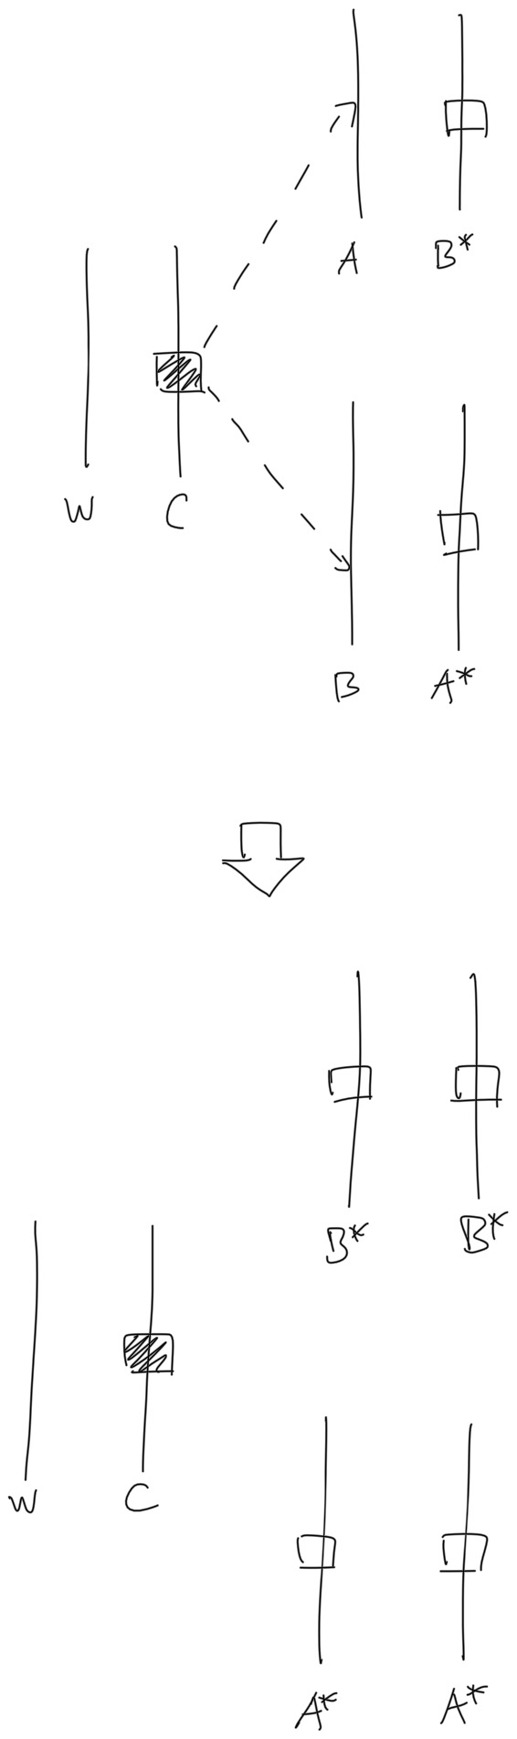
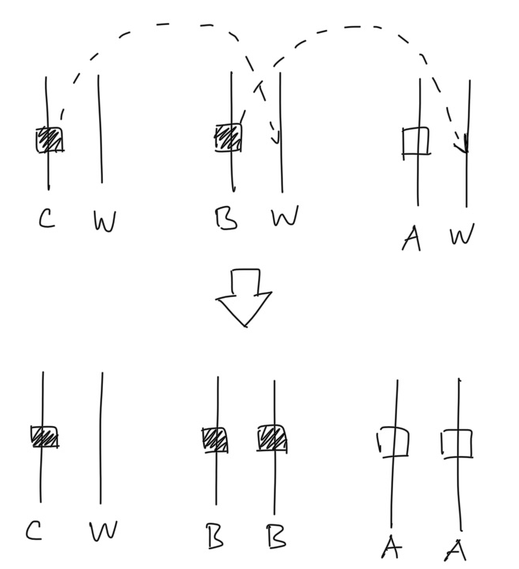
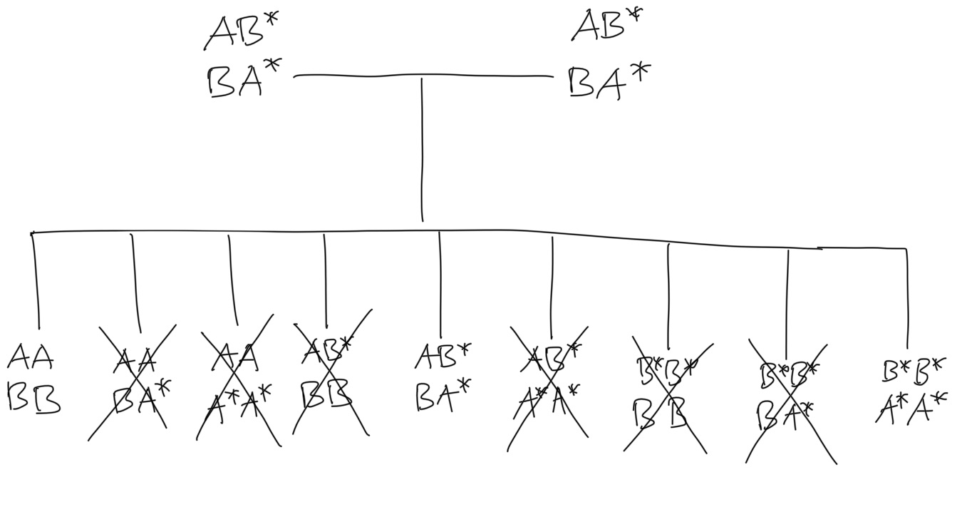
Daisy Quorum Gene Drive
Quorum
Daisy Drive
Notes:
What is daisy quorum gene drive? 2 parts: quorum, and daisy
For the quorum aspect, we have 2 haploinsufficient essential genes, A and B. Each individual must have 2 copies of A and 2 copies of B to be viable. In the wild, all individuals have genotype AABB. We can create an allele A* that is equivalent in function to A, but is inserted at the B locus, and an allele B* that is equivalent in function to B, but is inserted at the A locus. Here I’ve listed all of the possible genotypes that eventually occur when wild AABB and engineered B*B*A*A* mix. I’ve crossed out the genotypes that aren’t viable due to not having 2 copies of A and 2 copies of B, leaving only 3 left. Wild-type homozygote, heterozygote, and engineered homozygote.
In the dynamics of this system there are only 2 stable equilibria: 100% wild-type homozygote, or 100% wild-type engineered homozygote. Consequently, there will be a threshold such that a certain number of engineered individuals have to be released in order to achieve spread of the engineered alleles. Otherwise, the engineered allele will go extinct. This threshold behavior facilitates containment, because if only a few individuals escape the island then it’s unlikely they’ll be above the threshold.
Daisy drive means that rather than the drive allele cutting at the same locus, it cuts at a different one. By daisy chaining drive elements together, we can temporarily increase the proportion of A alleles in the population, at least until the C drive allele is too diluted by normal inheritance.
To combine them for daisy quorum gene drive, we have the engineered C drive allele that cuts A and B alleles to increase frequency of engineered B* and A* alleles. The quorum aspect creates a threshold effect for localized spread, and the daisy aspect lowers the threshold, increasing the practicality of the system.
1:56
----------------------------------------------------------------------------------------
Filled square = drive element
Empty square = cargo element
Threshold is 0.5 because fitness cost = 0.

Slide 4
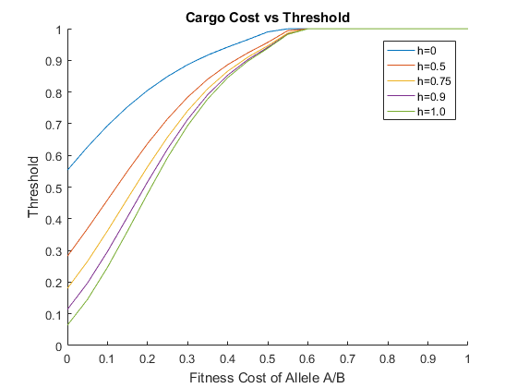
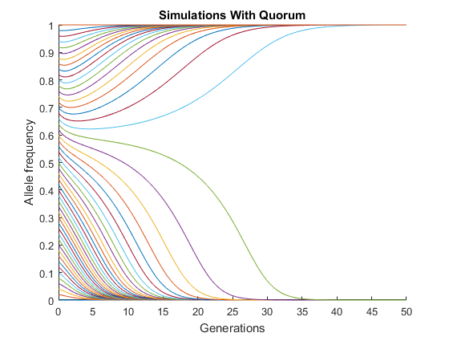
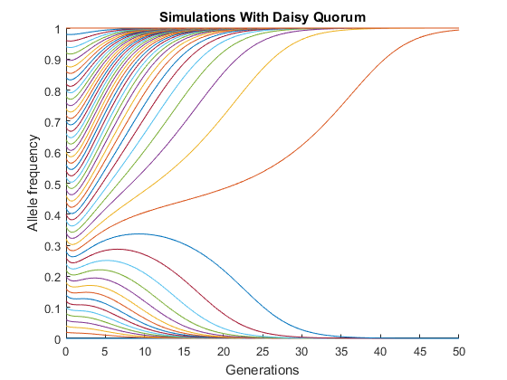
Adding Daisy Drive Decreases Quorum Threshold
Notes:
All of that was theoretical, but here are the simulations to prove it.
First 2 plots show frequencies of engineered A/B alleles over time. Each simulation starts at a different engineered allele release frequency, allowing you to see where the threshold is. One on the left is system with just quorum, while one on the right adds in a daisy element. You can see the threshold is clearly lowered.
With 3rd plot, the x axis is the fitness cost of the engineered alleles, and the y axis is the threshold of the engineered allele release frequency required for the engineered alleles to take over the population. Each line has a different homing efficiency: probability the drive allele successfully cuts and copies engineered allele in a heterozygote. You can see as probability of drive allele succeeding rises, the threshold decreases.

Slide 5
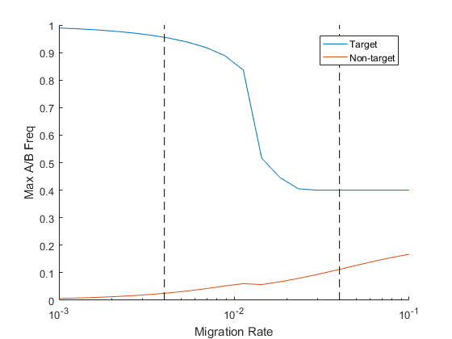
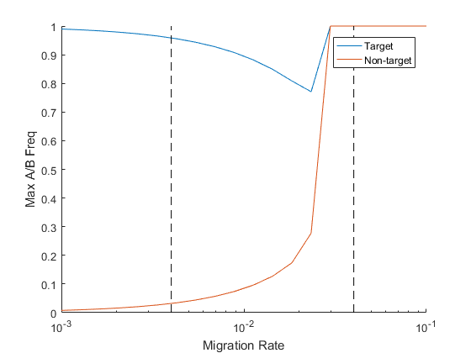
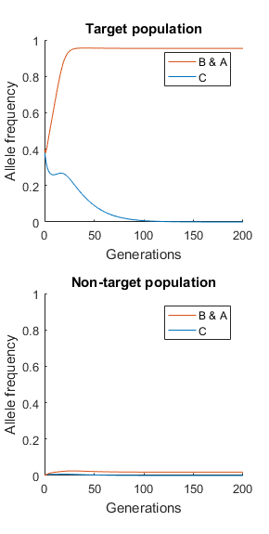
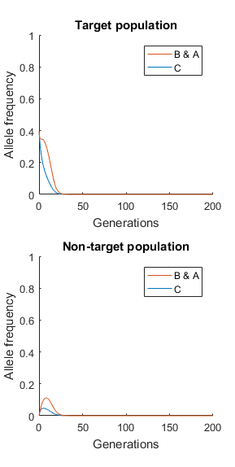
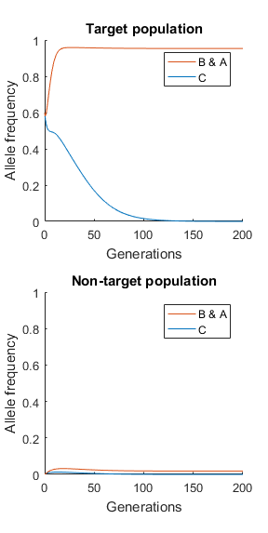
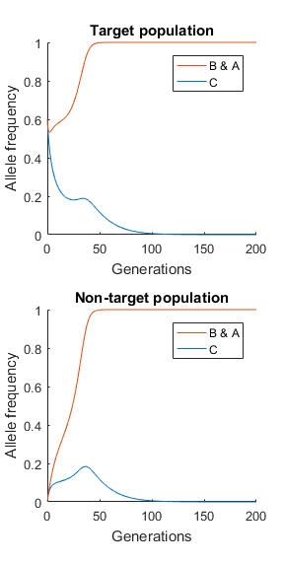

Slide 7
Migration Rate - Lower Release Frequency
Migration Rate: 4e-3
Migration Rate: 4e-2
4e-3
4e-2
Notes:
So now we’ve shown the threshold aspect of daisy quorum gene drive works as expected, but what about containment? To test this, we create a model with 2 populations where individuals move from one population to another at a given migration rate. We release engineered individuals in the target population, and track effects on both the target and non-target population.
With the 1st plot, the y axis shows the max spread of the engineered alleles. We can see that as migration rate increases, the engineered allele frequency decreases in the target population, but increases in the non-target population.
I picked out 2 points on the 1st plot to demonstrate how the simulation plays out with a lower and higher migration rate. With a lower migration rate, we get the desired result, where the engineered allele rapidly spreads throughout the target population, but stays at low-levels in non-target population. But as migration rate increases, it becomes less likely that the engineered allele frequency will fix.
Release frequency: 0.4

Slide 8
Migration Rate - Higher Release Frequency
Migration Rate: 4e-3
Migration Rate: 4e-2
4e-3
4e-2
Notes:
With a higher release frequency, the plot looks different. At low migration rates we get the same dynamics we hoped for, with the engineered allele fixing in the target population but going extinct in the non-target population. But at higher rates, the engineered allele fixes in both the target and the non-target population.
Conclusion: quorum aspect does produce thresholding behavior, so containment works as long as migration rate isn’t too high.
Release frequency: 0.6

Slide 9
Thank You!
To Chuck Noble for supervising me this semester
And others...

Slide 10
Appendix

Slide 11
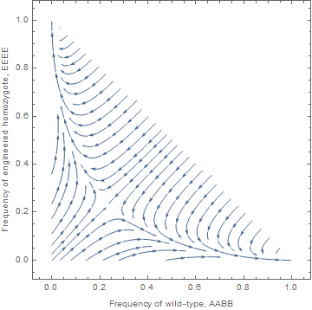
Quorum Analysis
Notes:
To understand the dynamics, we can take a look at the plot below. The x-axis is the proportion of wild-type homozygotes, and the y-axis is the proportion of engineered homozygotes. By subtracting the x-coordinate and the y-coordinate from 1, you get the proportion of heterozygotes. When you release engineered homozygotes into a population of wild-type homozygotes, you start on the diagonal line. You see this line here? If you start below this line, you will reach 100% wild-type homozygote, but if you start above, you will reach 100% engineered homozygote. This threshold behavior facilitates containment, because if only a few individuals escape the island then it’s unlikely they’ll be above the threshold.
But as you can see in this diagram, the threshold is fairly high: 0.5. And this is without even factoring in fitness costs of alleles. You’d need to produce a LOT of engineered individuals to reach 50% of the population, so we want to lower this threshold.

Slide 12
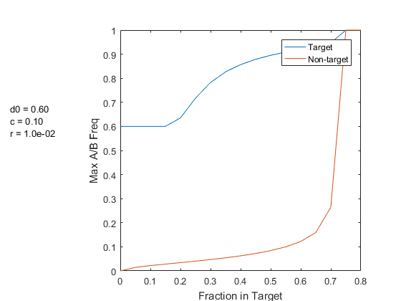
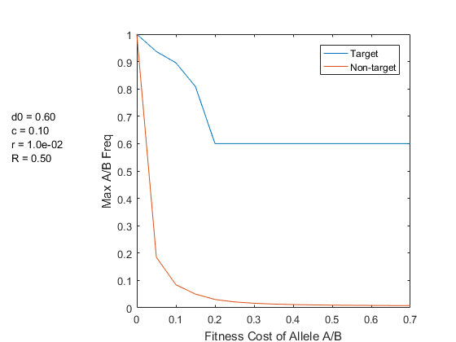
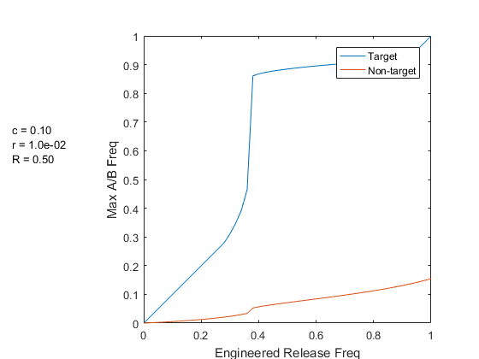
Quantitative Analysis of Other Parameters for 2 Populations

Slide 13
Image credit: www.sciencenews.org

Slide 14
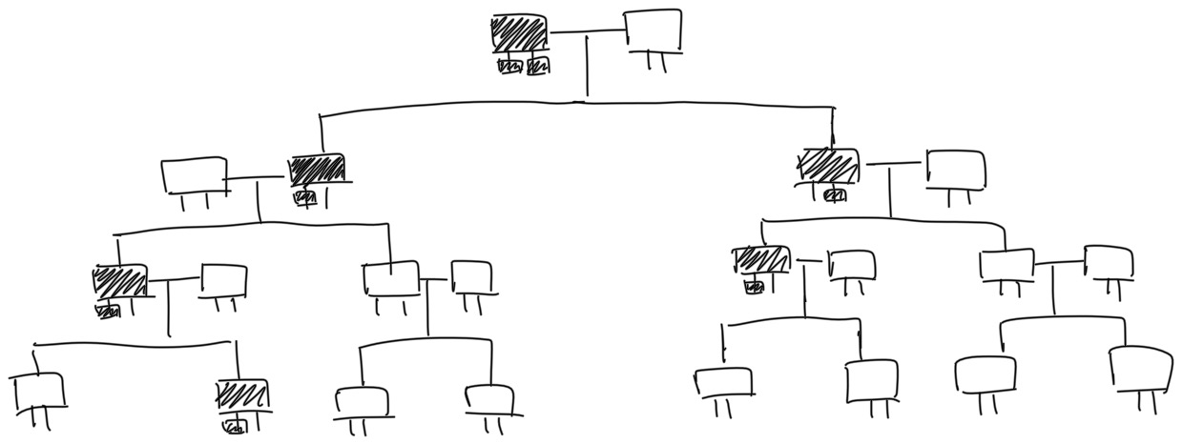
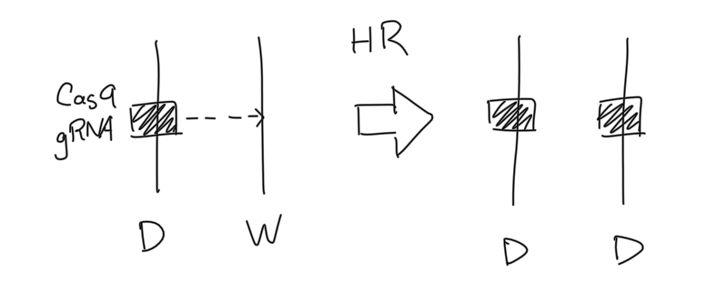
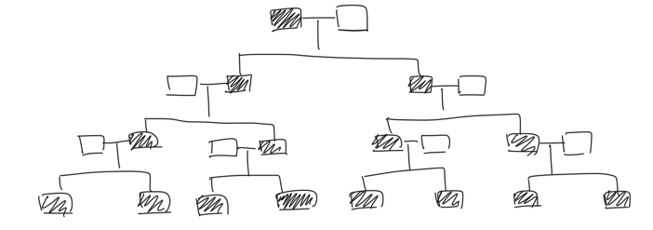
Gene Drive
Standard Dominant Inheritance
Drive Inheritance
Notes:
If we could genetically alter wild populations, we could potentially eradicate malaria by removing the malaria-carrying gene from mosquitoes. One promising mechanism is through “drive”, which means engineering an allele to bias its inheritance so that it will spread rapidly throughout a population. However, one of the biggest dangers with drive is that it could also spread to populations where we don’t want it to go. “Daisy quorum gene drive” is the potential solution to this problem that I will be discussing today.

Slide 15
Daisy Quorum Gene Drive
Quorum
Daisy Drive
Notes:
What is daisy quorum gene drive? 2 parts: quorum, and daisy
For the quorum aspect, we have 2 haploinsufficient essential genes, A and B. Each individual must have 2 copies of A and 2 copies of B to be viable. In the wild, all individuals have genotype AABB. We can create an allele A* that is equivalent in function to A, but is inserted at the B locus, and an allele B* that is equivalent in function to B, but is inserted at the A locus. Here I’ve listed all of the possible genotypes that eventually occur when wild AABB and engineered B*B*A*A* mix. I’ve crossed out the genotypes that aren’t viable due to not having 2 copies of A and 2 copies of B, leaving only 3 left. Wild-type homozygote, heterozygote, and engineered homozygote.
In the dynamics of this system there are only 2 stable equilibria: 100% wild-type homozygote, or 100% wild-type engineered homozygote. Consequently, there will be a threshold such that a certain number of engineered individuals have to be released in order to achieve spread of the engineered alleles. Otherwise, the engineered allele will go extinct. This threshold behavior facilitates containment, because if only a few individuals escape the island then it’s unlikely they’ll be above the threshold.
Daisy drive means that rather than the drive allele cutting at the same locus, it cuts at a different one. By daisy chaining drive elements together, we can temporarily increase the proportion of A alleles in the population, at least until the C drive allele is too diluted by normal inheritance.
To combine them for daisy quorum gene drive, we have the engineered C drive allele that cuts A and B alleles to increase frequency of engineered B* and A* alleles. The quorum aspect creates a threshold effect for localized spread, and the daisy aspect lowers the threshold, increasing the practicality of the system.
1:56
----------------------------------------------------------------------------------------
Filled square = drive element
Empty square = cargo element
Threshold is 0.5 because fitness cost = 0.

